Slide 1


Renton Fish and Game Club
USPSA
August 2022
Match Booklet
Match Director: Eric Beerbaum
Range Master: Marcel Englmaier
Stats: Marcel Englmaier
Round Count: 142

Slide 2
Stage 1: CM 22-03 Double Stacked
It’s one of the new ones. We do not have to pay the Classifier Fee(so no increased cost) and it won’t count until USPSA has enough data create a High Hit Factor to make them count.

Slide 3
Stage 2: CM 03-18

Slide 4
Stage 3 Pizza Hut Course Designer: Jordan Rogers
Pizza Hut is a 25 round, 125 point Comstock Long course. There are 10 IPSC targets and 5 steel targets. The best two hits per target will score. Steel must fall to score. The start signal is audible.
The start position is standing completely outside the shooting area with toes touching marks, facing DIRECTLY down range. Handgun: loaded and holstered. PCC: loaded, stock on belt, muzzle pointing down range.
On the audible start signal, engage all targets from within the shooting area. Popper 1 activates the drop turner, which is a disappearing target.

Slide 5
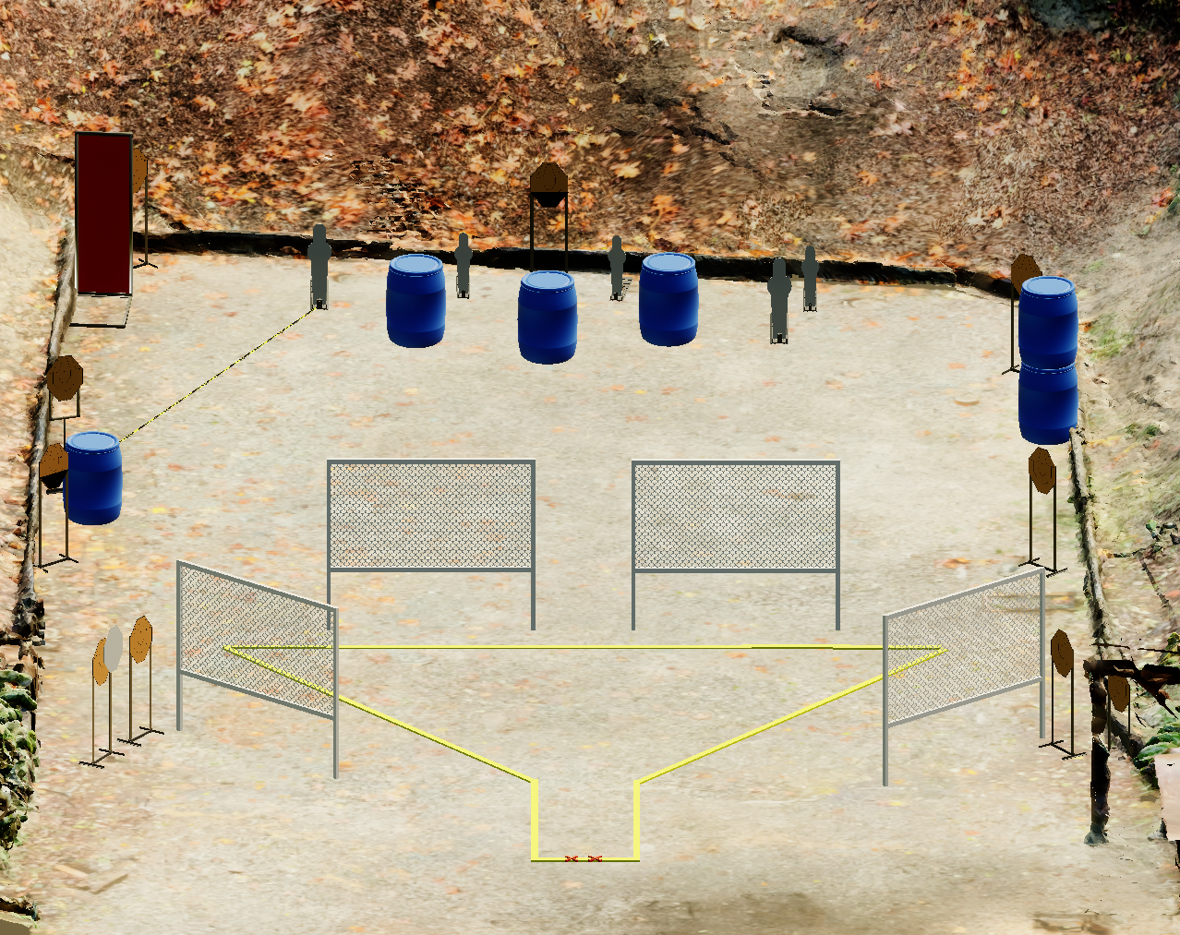
 | Stage 3 Pizza Hut Course Designer: Jordan Rogers

Slide 6
Stage 4 Gentle Spartans Course Designer: Jordan Rogers
Gentle Spartans is a 21 round, 105 point Comstock long course. There are 8 USPSA targets and 5 steel targets. The best two hits per target will score. Steel must fall to score. The start signal is audible.
The start position is standing anywhere within the shooting area with wrists above shoulders. Loaded firearm staged on any barrel, lying flat and unsupported with muzzle pointing downrange.
On the audible start signal, engage all targets within the shooting area.

Slide 7
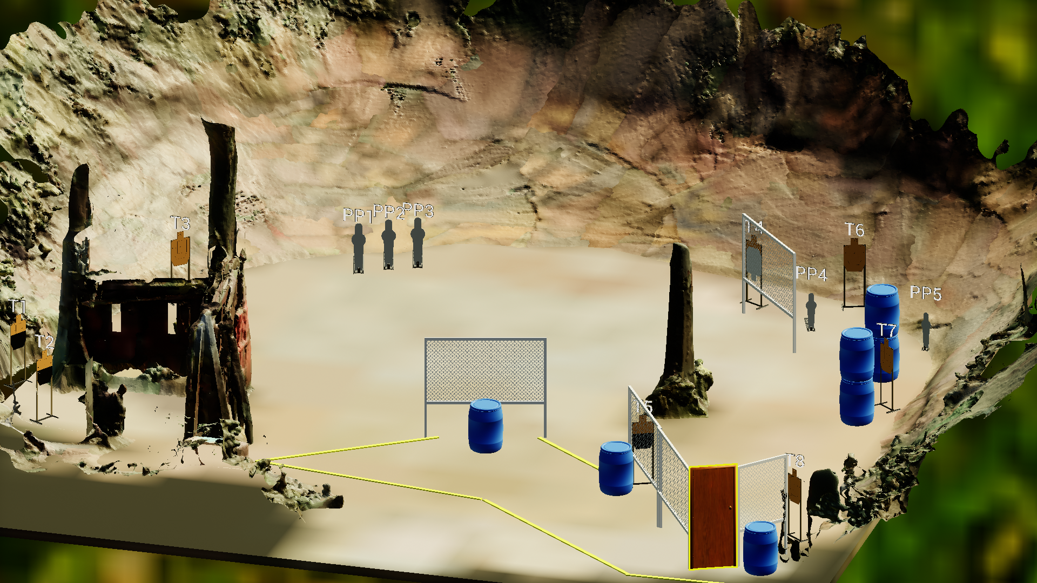
 | Stage 4 Gentle Spartans Course Designer: Jordan Rogers

Slide 8
Stage 5 Work The Corners Course Designer: Eric Beerbaum
Work The Corners is a 19 round, 95 point Comstock medium course. There are 8 USPSA targets and 3 steel targets. The best two hits per target will score. Steel must fall to score. The start signal is audible.
The Handgun start position is heels touching start stick, handgun loaded and holstered, wrists below belt. The PCC start position is heels touching start stick, PCC loaded, stock on belt, muzzle generally downrange.
On the audible start signal, engage all targets within the shooting area.

Slide 9
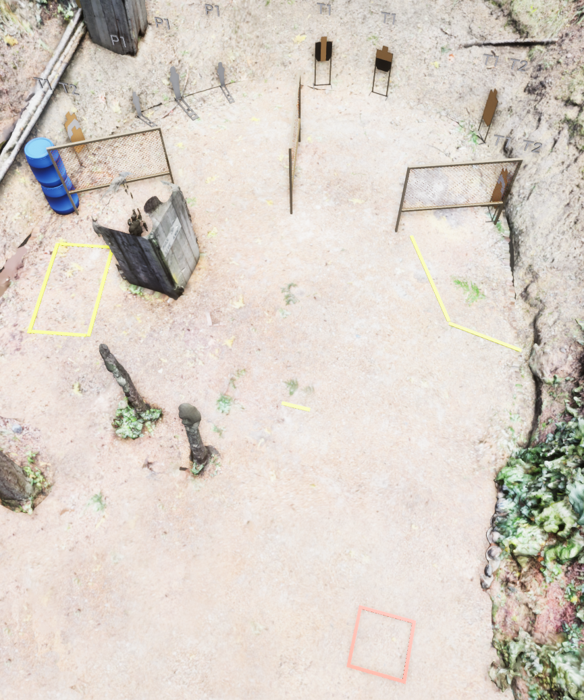
 | Stage 5 Work The Corners Course Designer: Eric Beerbaum

Slide 10
Stage 6
Take Your Time Or The Shot
Course Designer: Marcel Englmaier
Take Your Time Or The Shot is a 25 round, 125 point Comstock long course. There are 12 USPSA targets and 1 steel targets. The best two hits per target will score. Steel must fall to score. The start signal is audible
The Start position isn’t determined yet. Something inconvenient to a fluid stage execution.
On the audible start signal, engage all targets from within the shooting area.
Minipopper activates Flipup target
Notes:
‹#›

Slide 11
Stage 7
Tape Is Expensive
Course Designer: Eric Beerbaum
Aim Faster is a 16 round, 80 point Comstock long course. There are 14 USPSA targets and 2 steel targets. The best one hit per target will score. Steel must fall to score. The start signal is audible
The Handgun start position is anywhere outside shooting area, handgun loaded and holstered, wrists below belt.
The PCC start position is anywhere outside shooting area, PCC loaded, stock on belt, muzzle generally downrange.
On the audible start signal, engage all targets from within the shooting area.
Notes:
‹#›

Slide 12
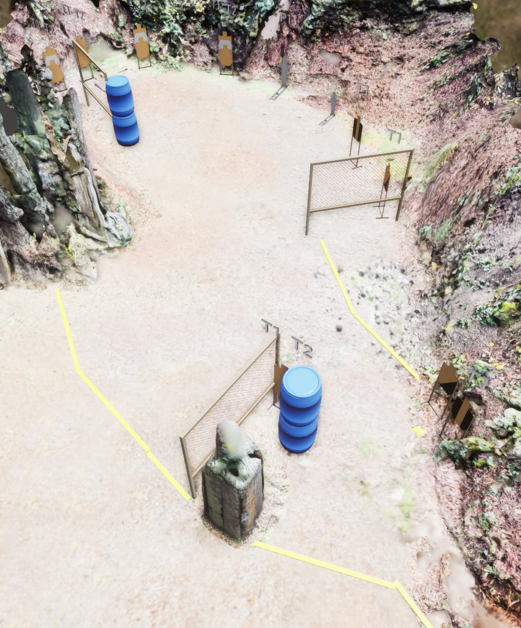
 | Stage 7 Tape Is Expensive Course Designer: Eric Beerbaum
Shooting Area 2
Shooting Area 1

